Slide 1

COMP8270 / PROGRAMMING FOR ARTIFICIAL INTELLIGENCE
The UK’s European university

Slide 2
overview:
Review ANNs
The Classification Problem
Using Keras for Classification

Slide 3
Brief Review of ANNs

Slide 4
ANN Review
We used an ANN to perform regression.
ANN: ℝ ➞ ℝ
Mapped numbers to more numbers.
The ANN acts as a function mapping continuous values (range) to a continuous value (domain).
Training data consists of continuous values, including the output.

Slide 5
The Classification Problem

Slide 6
Classification
An important problem is to predict membership of a set or a class.
Given an input, which group does it belong to?
Classification has many applications:
Image recognition
Disease diagnosis and prognosis
The outcomes of court cases
Credit risk
The ANN accepts an input vector (sometimes enormous) and predicts which class the input belongs to.
E.g. a jpeg of a hand-written digit ➞ { 0…9 }

Slide 7
A Classification Example
Recall our iris data set has 4 physical features: Sepal.Length
Sepal.Width
Petal.Length
Petal.Width
There are 3 species/categories/classes/LABELS: { setosa, versicolor, virginica }
Can we predict the species from the features?
Problem: How do we represent the classes to our ANN?

Slide 8
One-Hot Encoding
Idea 1: Does not work well
Assign each unique label a unique integer
Train with the integer labels.
{ setosa = 0, versicolor = 1, virginica = 2 }
Idea 2: One-Hot Encoding
Substitute a vector for the label.
The integer from Idea 1 is the index into the vector.
There is a 1 in the correct position, 0 everywhere else.
Our labels are { setosa, versicolor, virginica }
So versicolor would be [0, 1, 0]
Also supports multiple simultaneous labels.
Useful in textual applications.
We can do this with categorical input features as well.

Slide 9
Classification Output

Slide 10
Topology
Our regression ANN had 1 input and 1 output.
Classifiers typically have M:N inputs to outputs.
A black and white jpeg input that is 28x28 array is flattened to a 784 vector: 784 inputs.
The ANN’s output is a vector with an entry for every class.
Our iris example is a 4:3, 4 inputs and 3 classes.

Slide 11
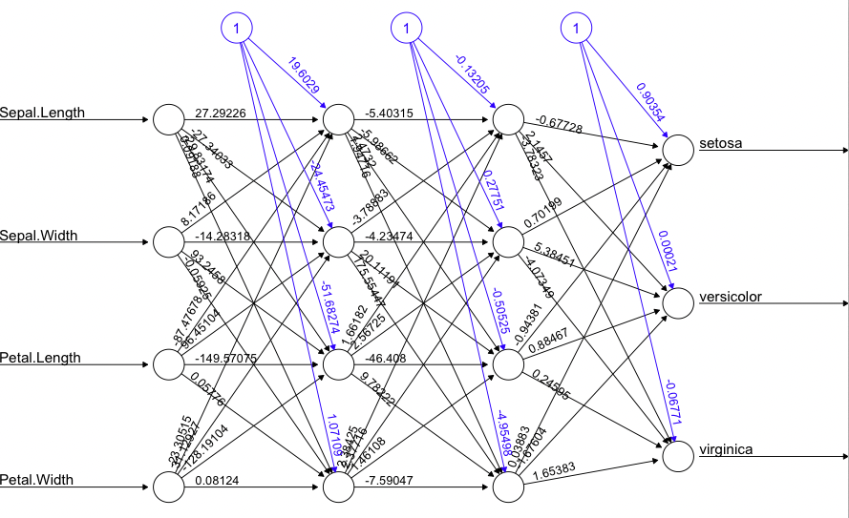
Iris Classification ANN

Slide 12
Iris Classification ANN
Softmax

Slide 13
Softmax: Imposes Interpretability
The output is a vector, but how do we know which class was predicted?
The softmax method accepts the vector and produces a set of “probabilities”.
We select the highest probability as the choice.
Our labels are { setosa, versicolor, virginica }, so:
Softmax ([-22, 1.3, 0.5]) ➞ [5.24e-11, 0.69, 0.31]
max ([5.24e-11, 0.69, 0.31]) ➞ versicolor

Slide 14
Input Pre-processing

Slide 15
Input Normalization
Non-categorical features are considered continuous.
ANNs are very sensitive to input data.
The training data needs to be pre-processed prior to use.
Ideally, for a feature, F, we have x ∊ F, -1 ≤ x ≤ 1
We can divide by max (|F|).
We also need mean (F) = 0.0
We can subtract the mean element-wise.
x_{i} = x_{i} - mean (F)

Slide 16
Summary
Classifiers predict membership of an input vector in a group.
Classifiers have multiple inputs and outputs.
One output for each class of interest.
Input data needs to be pre-processed prior to training.
We apply Softmax to the output of the ANN for the final classification.

